Slide 1

COURSE CODE: 413

Slide 2
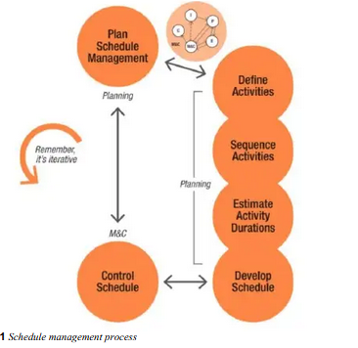
PROJECT SCHEDULE MANAGEMENT
Project scheduling is the process of defining project activities, estimating their duration, sequencing them logically, and assigning resources to ensure the project is completed within the planned time frame.
A well-structured schedule helps the project team stay on track, monitors progress, and identifies potential delays before they become critical issues.

Slide 3

PLAN SCHEDULE MANAGEMENT
The main objective of Schedule planning Management is to establish the guidelines, methods, and tools that will be used to create and manage the project schedule effectively.
Schedule planning Management covers the processes of defining how the project's schedule will be developed, executed, and controlled.

Slide 4
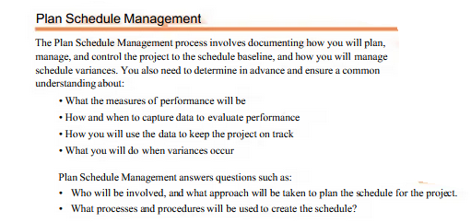

Slide 5
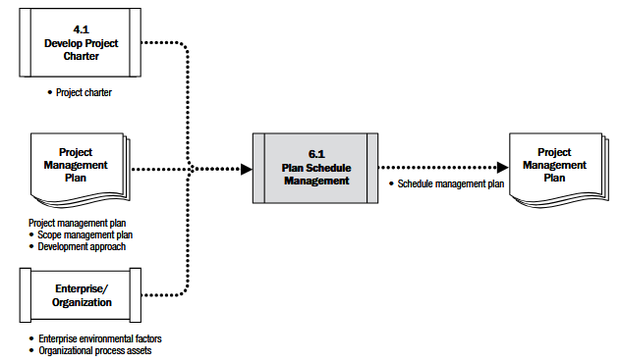
SCHEDULE MANAGEMENT PLAN

Slide 6
KEY TERMINOLOGIES IN PROJECT SCHEDULING
Term | Definition
Project Schedule | A detailed plan that outlines start and finish dates for project activities.
Schedule Baseline | The approved version of the project schedule, used as a reference to measure progress.
Activity | A specific task or work package that needs to be completed as part of the project.
Activity List | A document that includes all activities needed to complete the project.
Activity Duration | The estimated time required to complete a specific task.
Predecessor Activity | An activity that must be completed before another activity can start.
Successor Activity | An activity that follows another activity in the project schedule.
Critical Path | The longest sequence of dependent activities that determine the shortest possible project duration.
Float (Slack) | The amount of time an activity can be delayed without delaying the overall project.
Leads and Lags | Lead: An activity starts before its predecessor finishes. Lag: A delay between dependent activities.
Milestone | A significant event or achievement in the project schedule (e.g., project phases, approvals).
Gantt Chart | A visual representation of the project schedule showing activities over time.
Schedule Compression | Techniques like crashing or fast-tracking used to shorten project duration.
Earned Value Management (EVM) | A method to measure project performance against the schedule and cost baselines.

Slide 7
THE FOUR TYPES OF LOGICAL RELATIONSHIPS
A
B
The most common dependency
FINISH-TO-START (FS) DEPENDECY
A
B
START-TO-START (SS) DEPENDECY
A
B
FINISH-TO-FINISH (FF) DEPENDECY
START-TO-FINISH (SF) DEPENDECY
A
B

Slide 8
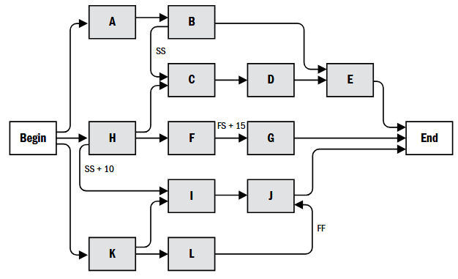
DEPENDECY COMBINATION WITHIN A NETWORK
It should be noted that in all cases the dependencies can be used in combination. The most commonly used pairing is the START-TO-START (lag-start) and FINISH-TO-FINISH (lag finish)

Slide 9
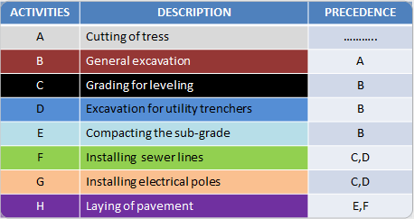
PRECEDENCE RELATIONSHIP
List activities in a typical road construction project, create the corresponding WBS and discuss the interdependencies of these activities.
H
Activity on Node (AON)
E
A
B
D
F
START
FINISH
C
G

Slide 10
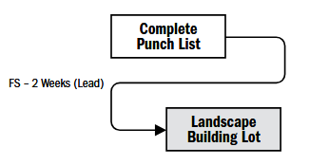
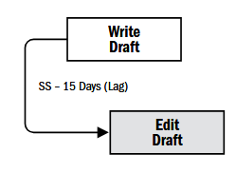
LEAD AND LAG
LEAD is the acceleration of the successor activity.
This means the amount of time a successor activity can be advanced with respect to predecessor activities
LAG indicate a delay in the predecessor activity.
This means the amount of time the successor activity will be delayed with respect to the predecessor activity

Slide 11
DEPENDENCY DETERMINATION
Mandatory dependencies: These dependencies are form of physical limitation. They are also known as hard logic. Example: You can’t commence building until you receive government approval to build.
Discretionary dependencies: These dependencies may be at the discretion of the project manager. They are based on the knowledge of best-practice or project team’s expertise based on past experiences. They are also called ‘preferred or soft logic’. Example is adoption of new approach due to expertise.
External dependencies: These dependencies are external to the project team. Example is government approval before continuation of project.
Internal dependencies: These are internal dependencies involving a precedence relationship between project activities and are within the control of the project team’s control. Example: when a project team agreed within themselves to first complete assembling the system before carrying out their test.

Slide 12
Resource availability
fundamentally shapes project schedules by dictating what's possible, directly causing delays, extending project duration, altering critical paths, and impacting costs and quality when resources (people, equipment, funds) are scarce or misaligned with task demands, leading to bottlenecks, idle time, or rushed work, necessitating realistic resource-constrained scheduling to balance capacity and needs.
Good resource management ensures the right resources are available at the right time, maximizing productivity and outcomes; poor management creates delays, budget overruns, and dissatisfaction, highlighting the need for realistic scheduling that accounts for resource limits
Key Impacts on Schedules
Project Delays: Insufficient resources at the right time force tasks to start late, extending the entire project timeline.
Critical Path Alterations: Limited resources can make previously non-critical tasks critical, creating new dependencies and increasing schedule sensitivity, as shown in this YouTube video.
Increased Costs & Quality Risks: Delays often lead to higher costs; to compensate, scope might be cut or quality compromised, affecting deliverables.
Bottlenecks & Inefficiency: Over-allocation of a resource creates bottlenecks, while under-utilization leads to wasted time and money.
Reduced Flexibility: Resource constraints make schedules less flexible, requiring tighter sequencing and making changes harder to absorb.
How Resource Availability Changes Planning
Resource-Constrained Scheduling: Instead of fixing time and adjusting resources, this approach fixes resources (within capacity) and adjusts time, creating more realistic plans.
Prioritization: When resources are scarce, some tasks must be delayed to prioritize others, often based on strategic importance.
Balancing Workloads: Effective tracking balances work across team members, preventing burnout and maximizing overall output.

Slide 13
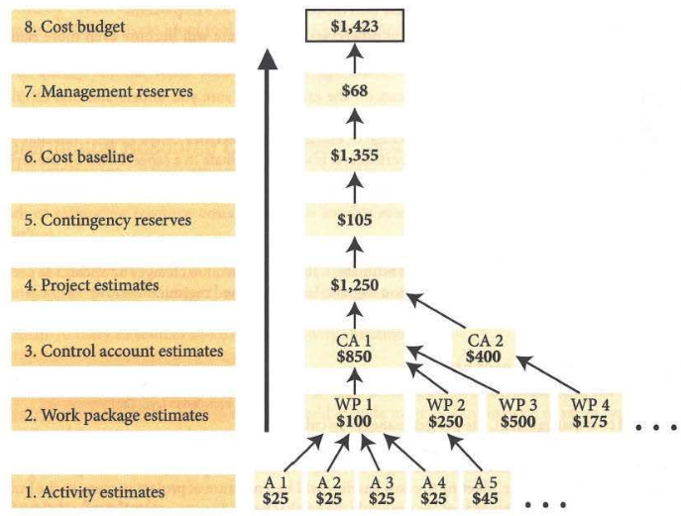
A Project Budget is the estimated total cost required to complete a project successfully. It includes all expenses related to resources, labor, materials, equipment, and contingency reserves.
The project budget serves as a financial roadmap, ensuring that funds are allocated efficiently and costs are controlled throughout the project lifecycle. It is a key component of Project Cost Management in PMI’s PMBOK Guide.

Slide 14
KEY TERMINOLOGIES IN RELATED TO BUDGET
Term | Definition
Project Budget | The total approved cost estimate for the project, including all planned expenses.
Cost Baseline | The approved version of the budget used to measure project performance.
Budget Estimate | The forecasted cost of the project, calculated using estimation techniques.
Direct Costs | Costs directly related to project execution (e.g., labor, materials, software).
Indirect Costs | Overhead costs that support the project but are not directly tied to project work (e.g., office space, utilities).
Contingency Reserve | Funds set aside for known risks that may occur during the project.
Management Reserve | Additional funds allocated for unknown risks or unforeseen events.
Earned Value (EV) | The value of work actually completed, used to track budget performance.
Planned Value (PV) | The estimated cost of scheduled work at a given point in time.
Actual Cost (AC) | The total cost incurred for work performed at a given time.
Cost Variance (CV) | The difference between Earned Value (EV) and Actual Cost (AC) (CV = EV - AC).
Cost Performance Index (CPI) | A measure of cost efficiency (CPI = EV / AC). A CPI > 1 means the project is under budget, while CPI < 1 indicates overspending.
Estimate at Completion (EAC) | A forecast of the total project cost based on current performance.
Bottom-Up Estimating | A cost estimation method that calculates the total budget by summing up individual work package costs.
Analogous Estimating | A high-level estimation technique that uses historical project data to predict costs.
Parametric Estimating | Uses mathematical models to estimate costs based on variables (e.g., cost per unit).
Cost Control | The process of monitoring costs, managing budget changes, and ensuring financial alignment.

Slide 15
Procurement: The overarching process of sourcing, negotiating, and strategically acquiring goods, services, or works from an external source, often involving a competitive bidding process.
Vendor/Supplier: A company or individual that provides goods or services to another entity.
Contract: A legally binding agreement between a buyer and a supplier that defines the terms, conditions, rights, and obligations regarding the purchase of goods or services.
Analogous Estimate(historical comparison): is a top-bottom estimating technique used for estimating the project duration or cost of an activity using historical data from a similar activity or project. It is generally less costly, less accurate and less time-consuming but most reliable. It is ideal for management use.
Bottom-up Estimate: Bottom-up estimating is a method of estimating project duration or cost by aggregating the estimates of the work packages. It is time consuming, but most accurate of all the estimating techniques

Slide 16
Traditional Projects Use The Following Estimating Techniques:
Range. Estimates are better done in range. For example, range of -25 to +75% is at the start of exploring a project opportunity, while projects that are well along in their life cycle may have an estimating range of -5 to +10%.
Analogous Estimate: is a top-bottom estimating technique used for estimating the project duration or cost of an activity using historical data from a similar activity or project. It is generally less costly, less accurate and less time-consuming but most reliable. It is ideal for management use.
Bottom-up Estimate: Bottom-up estimating is a method of estimating project duration or cost by aggregating the estimates of the work packages. It is time consuming, but most accurate of all the estimating techniques
Parametric Estimating: This is a quantitative estimate of multiplying quantity of work by the time rate used in doing a unit of the work based on past experience or an estimating technique that uses algorithm to calculate cost or duration based on statistical relationship or historical data.

Slide 17
QUIZ

